Slide 1
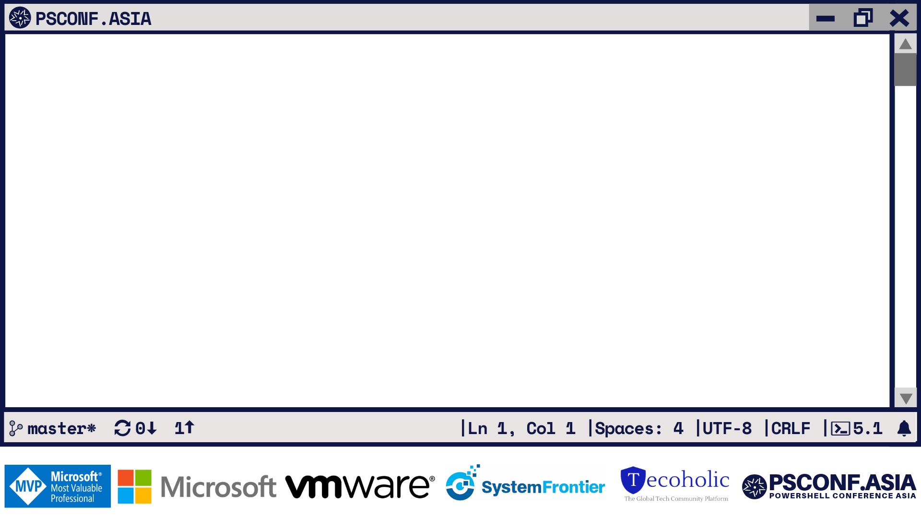
Living Nightmare!
Deploying an application in PowerShell
Graziella Iezzi IT Business Applications Specialist, Booking.com

Slide 2
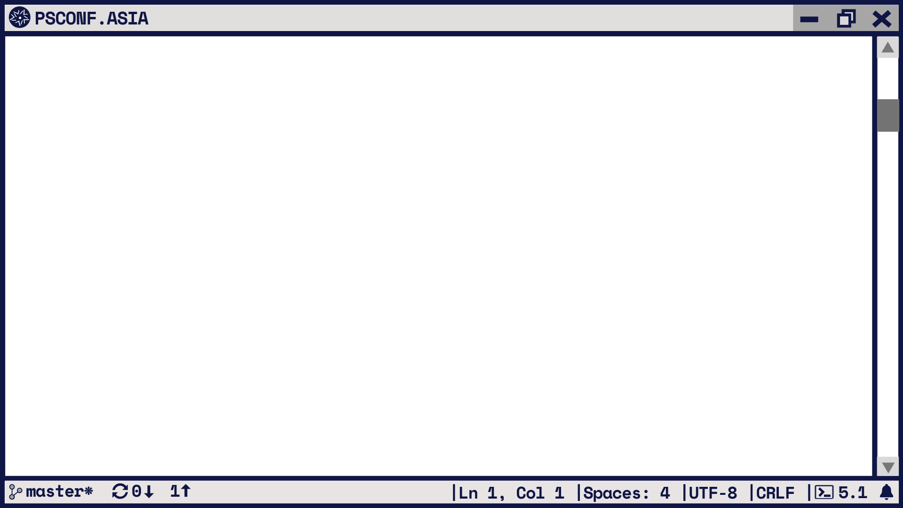
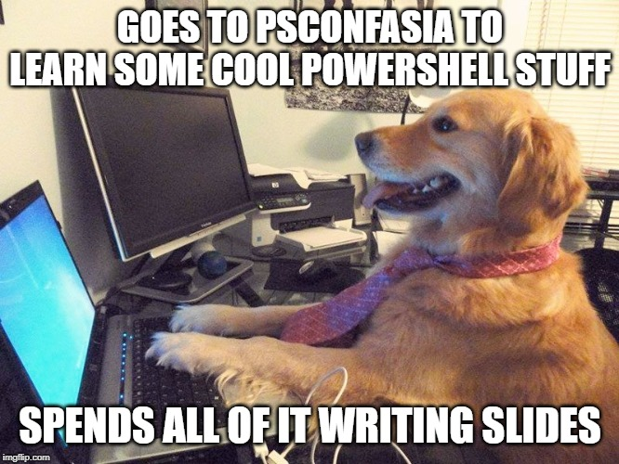

Who am I
Graziella Iezzi
IT Business Applications
Specialist @ Booking.com
Passionate about tech stuff.
Not my hobby though!
@lunagra80

Slide 3
What to expect
It’s a storytelling:
How designing a solution looks like (sometimes)
“Looks easy to do” not always means what it means
No one is perfect - you can learn from each one of your errors

Slide 4
Agenda
How I got into PowerShell and automation
What’s the problem I tried to solve
Nightmare 1: Hardware and OS
Nightmare 2: Invoke-RestMethod and HashTables
Nightmare 3: Importing a zip file through API
Takeaways
Questions

Slide 5
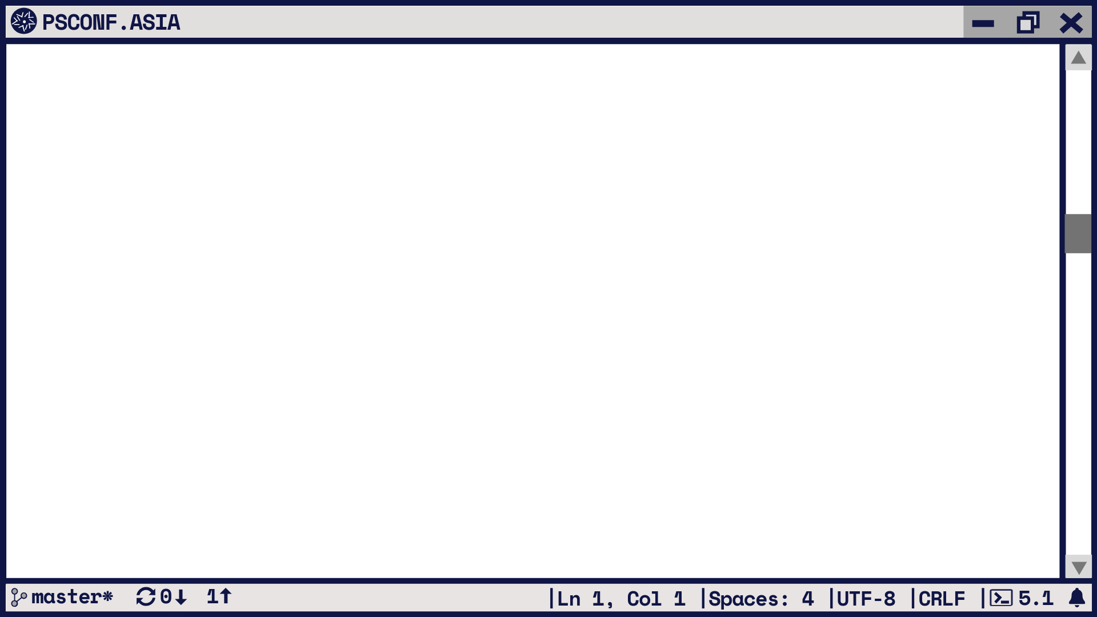
How I fell in love with PowerShell
“Oh! You touched this code, it’s yours now!!”
Starting small
Automate, automate, automate! (Even when you don’t know what it means)

Slide 6
What problem I tried to solve?
Having cluster redundancy
Fast deployment of an application
Easy maintainability
Lack of resources
“Can I have a button to click and *BAM* I have the application installed, configured and ready to be used?”

Slide 7
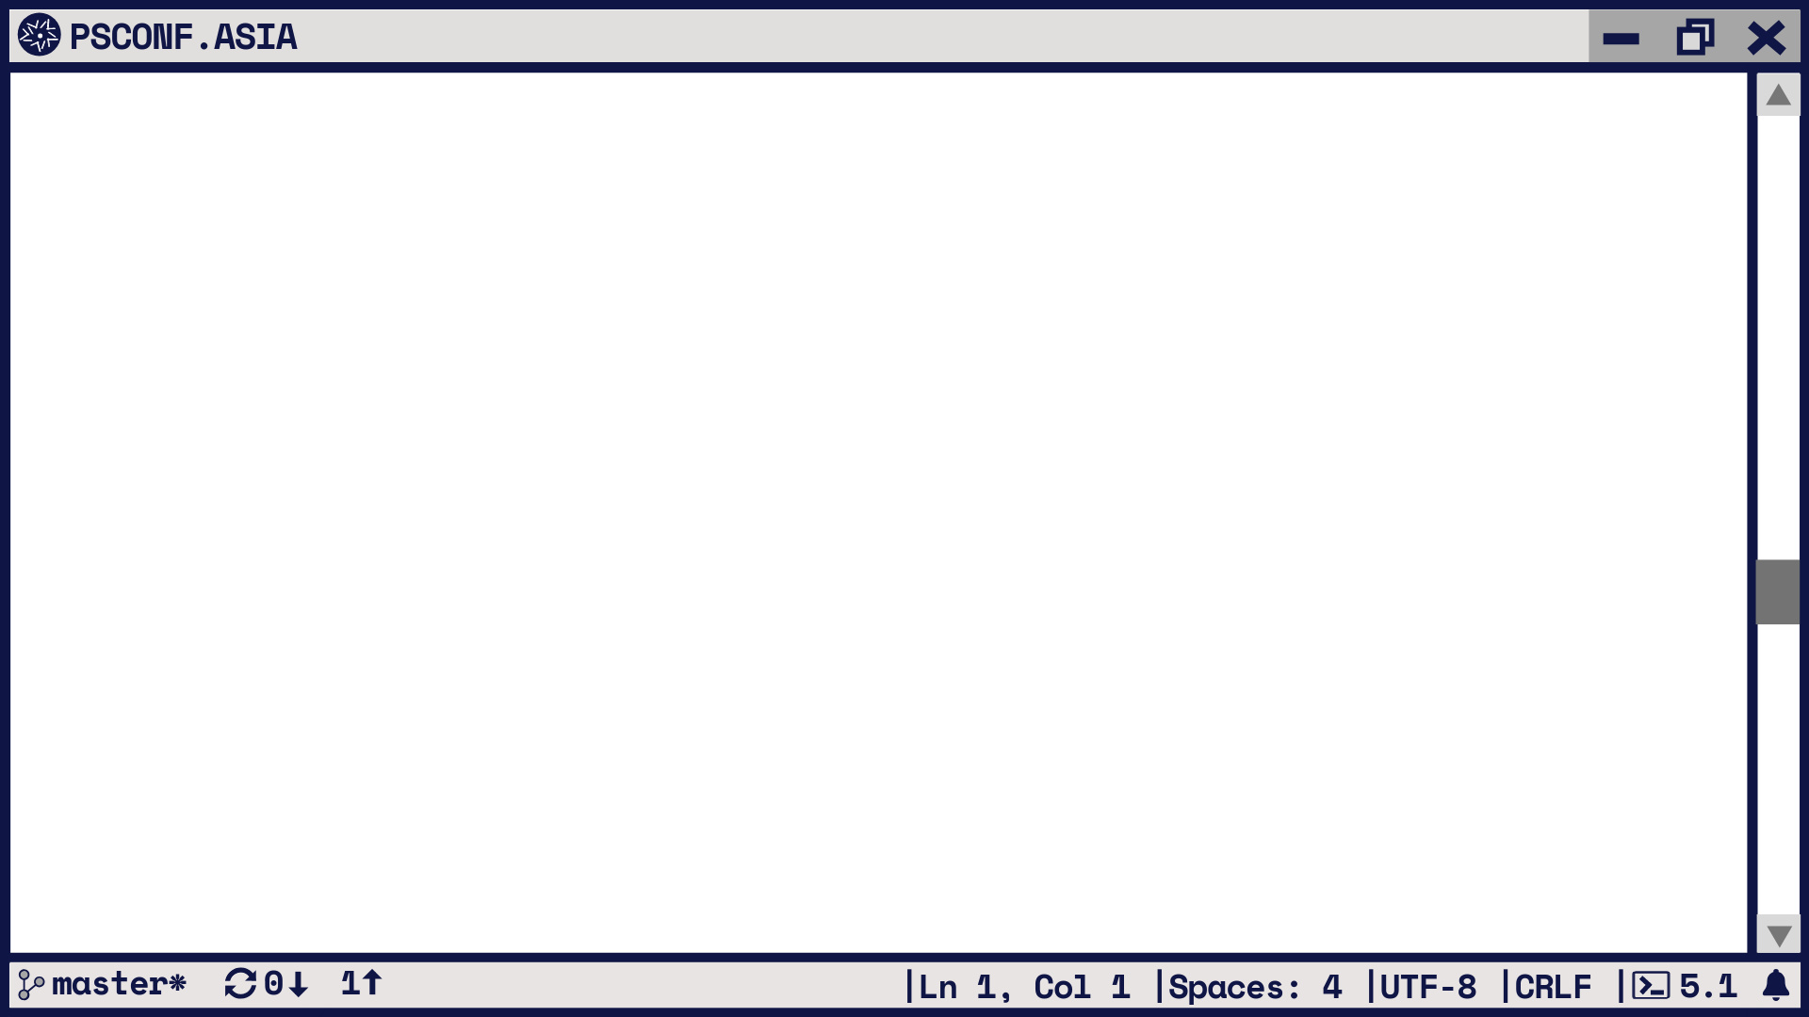
Designing: what to consider
Look around you are not only one that wants to do it
Infrastructure (servers, OS, networking, security)
Automation piece:
what solutions are out there, which ones can you actually use?
where to store secrets?

Slide 8
Designing: what to consider
Application:
what exactly do you do manually?
installing the application
configure files
do you need to configure the OS further? (i.e. open ports, create local users to run the service)
do you need configure/upload the license, or other files from somewhere else
how to provision users (i.e. Okta, SAML, LDAP)
does the vendor provide an endpoint for what you need?

Slide 9
Nightmare 1: Hardware and OS
What we currently have:
one production cluster
no test, UAT, DR environments
no support for the OS
What we are trying to improve:
fast way to spin up a new environment
not to worry about the underneath infrastructure (much)
What we can do even better:
faster way to spin up a new environment
not to worry about the underneath infrastructure at all

Slide 10
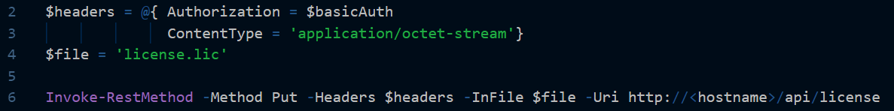
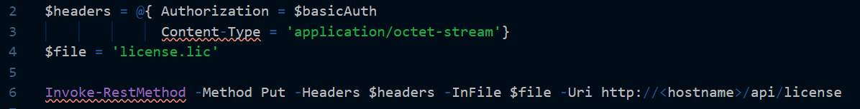
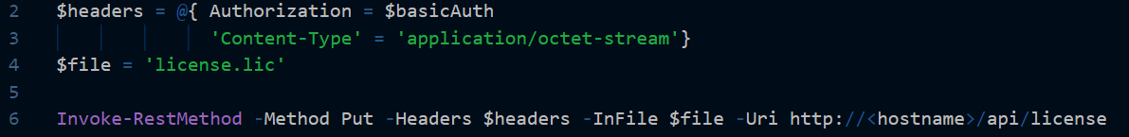
Nightmare 2: Invoke-RestMethod and Hashtables

Slide 11
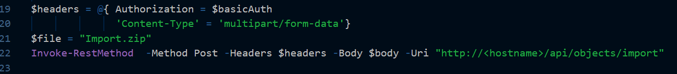
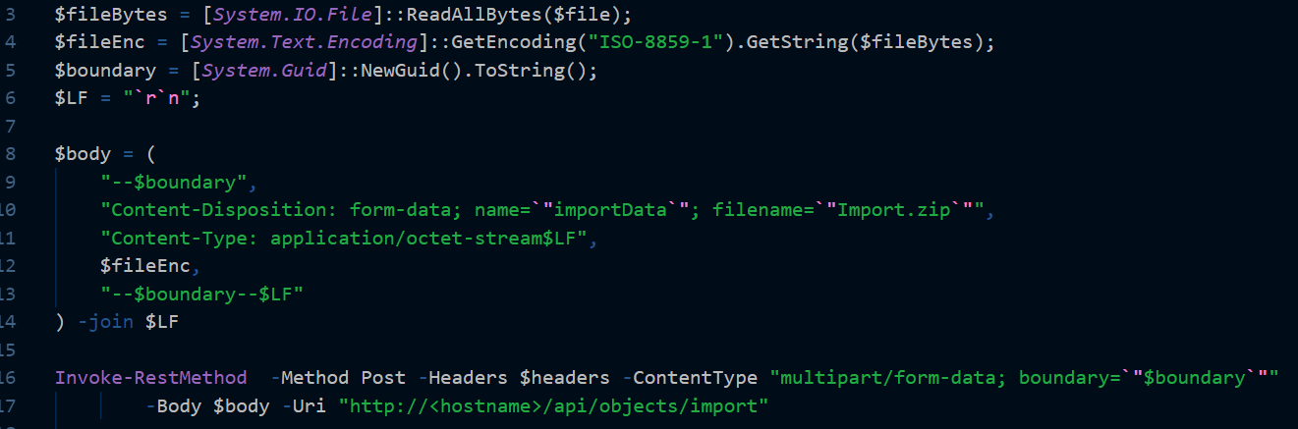
Nightmare 3: Importing a zip file through API

Slide 12
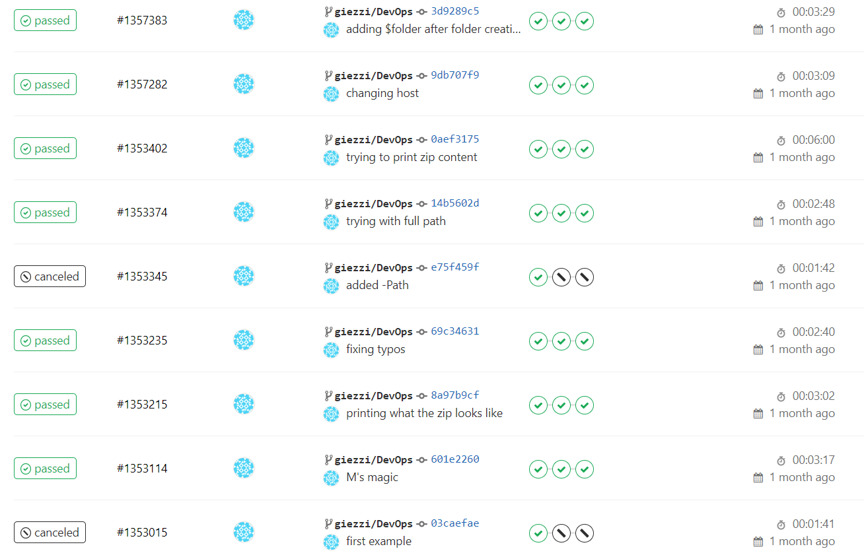
Nightmare 3: Importing a zip file through API

Slide 13
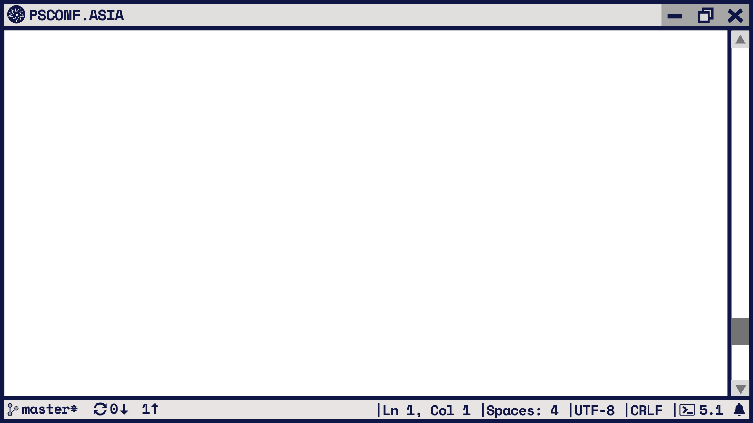
Takeaways
Your job can evolve just embrace it
Things are easy when you know already the answer
Impostor syndrome: we all have it!
The PowerShell community is awesome!

Slide 14
